Slide 1

Multimodal Feedback for Mid-air Gestures when Driving
Gözel Shakeri

Slide 2

Mid-air Gestures in Cars
Youtube Channel: BMW USA
Title: Gesture Controls | BMW Genius How-To
Link: https://www.youtube.com/watch?v=wqvAPskg_k0
Notes:
Mid-air gestures allow drivers to control in-car systems without taking their eyes off the road.
This has the potential to minimise distraction and improve safety by replacing complexactions (e.g., precisely selecting buttons on touchscreens) with simple hand movements (e.g., swiping the hand in mid-air to reject a phone call).

Slide 3
Mid-air Gestures in Cars
Problem Statement
Mainly visual feedback
Usability challenges
System attention
User intention
Sense of control
Youtube Channel: BMW USA
Title: Gesture Controls | BMW Genius How-To
Link: https://www.youtube.com/watch?v=wqvAPskg_k0
Notes:
However, mid-air gestures lack critical clues which are essential in human-computer interaction: feedback. Feedback is necessary if gesture interaction is to be successful.
Current mid-air gesture systems in cars only give limited and mainly visual feedback on the centre console screen. If drivers need to take their eyes off the road to understand their interactions with the car, then the benefits of mid-air gestures are not being fully realised.
Further, gestures are prone to usability challenges which may increase frustration and workload. Good feedback can overcome these issues.Feedback informs the user whether the system pays attention to them, whether the user addressed the system correctly, and whether the user’s intention was correctly understood by the system.

Slide 4
Multimodal Feedback for Mid-air Gestures in Cars
Beneficial for non-driving related tasks
Beneficial for gesture interaction
Thesis Contributions:
Cutaneous Push
Peripheral Lights display
Ultrasound haptics
Notes:
Multimodal feedback is when information is distributed to multiple sensory modalities; such information presentation to the tactile (touch), auditory, olfactory (smell), etc.
A plethora of research has shown that Multimodal feedback is beneficial for non-driving related tasks AND it is beneficial for gesture interaction.
Therefore, my work investigated the design and evaluation of successful multimodal mid-air gesture feedback for driving scenarios. Three novel feedback types for mid-air gestures were investigated to address and minimise visual distraction, mental workload, and user uncertainty without negatively affecting driving nor gesture performance:
Cutaneous Push
Peripheral Lights displays
Ultrasound haptics
I will present these one by one in the next slides.

Slide 5
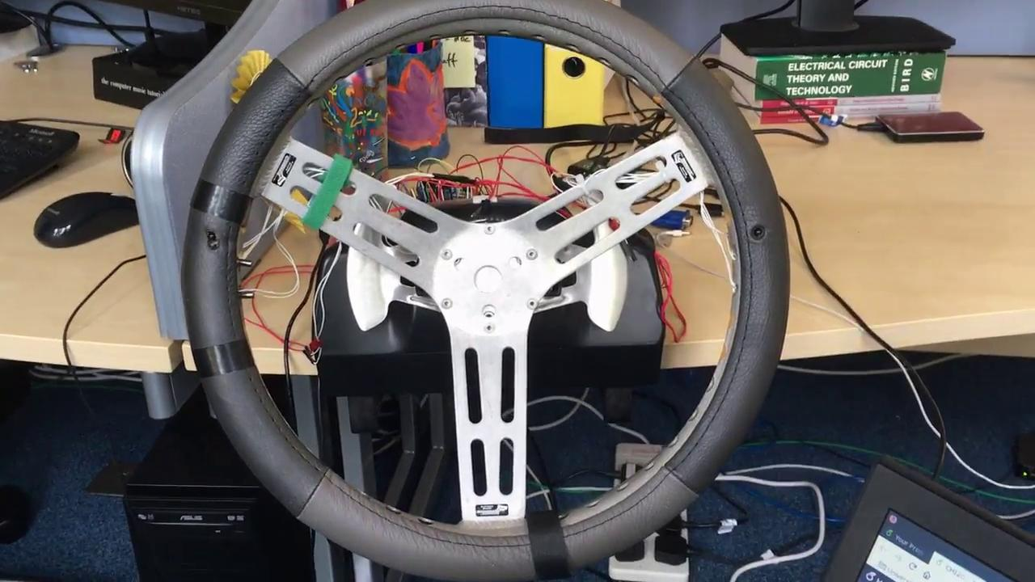
Cutaneous Push Feedback
Rich messages,
Maintains high spatial accuracy,
Conveys robust cues,
Presents them quickly.
Notes:
Tactile feedback is a core part of providing a sense of agency to the gesturing driver, whilst also reducing eyes-off-the-road time. The Cutaneous Push steering wheel, as seen here in the video, provides information to the driver via 6 solenoids pushing against the palm.
Cutaneous Push 1) delivers rich messages, 2) maintains high spatial accuracy, 3) conveys robust cues(unmistakable for natural torque or in-car vibration), and 4) presents them quickly. These are important variables in a driving environment.

Slide 6
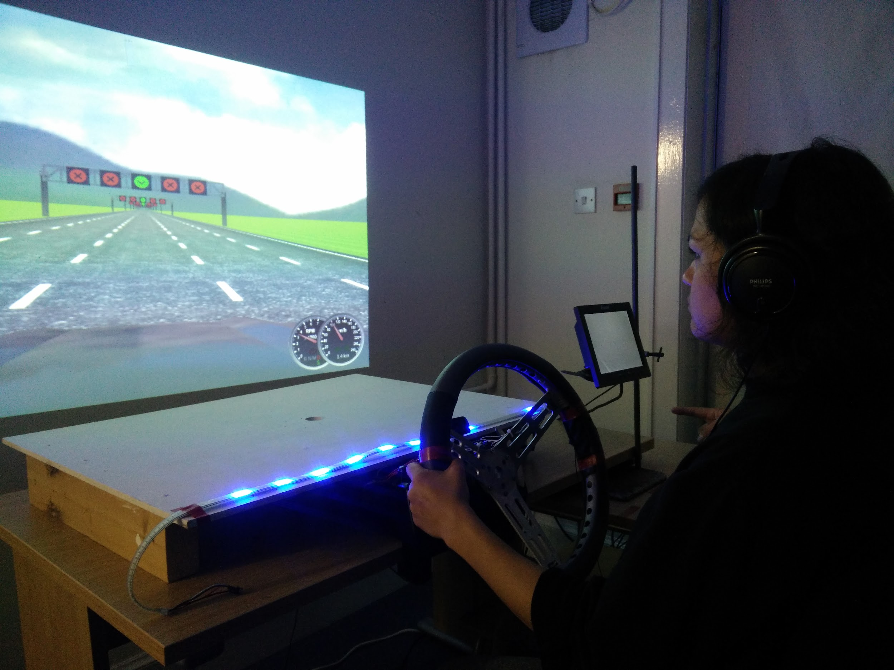
Peripheral Lights Feedback
No interference in demanding environments,
Effectively conveys information with no additional cognitive demand.
Notes:
The Peripheral Lights feedback was displayed on a single LED strip from the A-pillar on the left side of the driver to the beginning of the centre console. The strip was placed behind the steering wheel where the car instrument cluster would be, as can be seen on the image.
The benefits of Peripheral Lights are 1) it does not interfere with the primary task in demanding environments (e.g. aeroplane cockpits), 2) Effective solution to convey information in data driven environments with no additional cognitive demand.

Slide 7
Ultrahaptics Feedback
Provides information to the unadorned hand in mid-air,
Increases sense of control,
Reduces visual distraction during gesture interaction.
Youtube Channel: BristolIG Lab
Title: Rendering Volumetric Haptic Shapes in Mid-Air using Ultrasound
Link: https://www.youtube.com/watch?v=kaoO5cY1aHk
Notes:
Ultrasound haptics is an alternative feedback modality for message delivery to the hand. Focused ultrasound creates areas of acoustic radiation pressure which make haptic shapes and patterns perceivable on the skin of the hand. The benefits of ultrahaptics are 1) it provides information to the unadorned hand in mid-air, 2) Increases sense of control, 3) Reduces visual distraction during gesture interaction.
In the in-car studies, the ultrasound array, as seen in the short video, was placed where the gear stick would be.
Prior to this work, the impact of ultrasound feedback for gesturing had not been investigated, neither on driving performance, visual and cognitive distraction, nor secondary task performance. This was and is a timely problem, as some production vehicles (e.g. BMW, Jaguar Landrover) use ultrasound haptics for gesture interaction with their in-car systems.

Slide 8
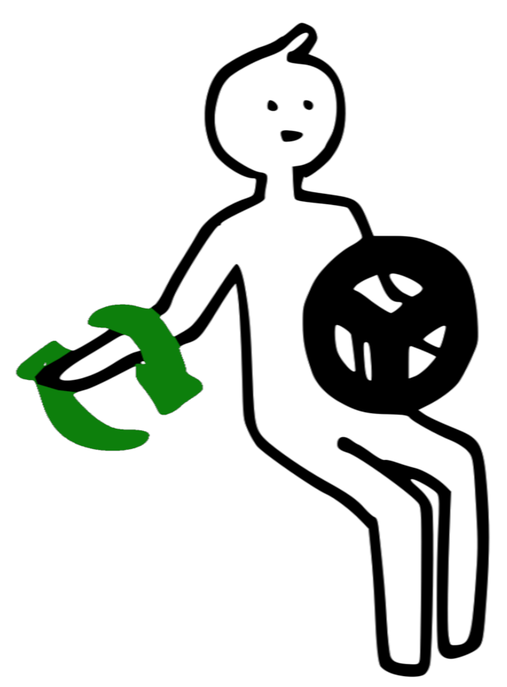
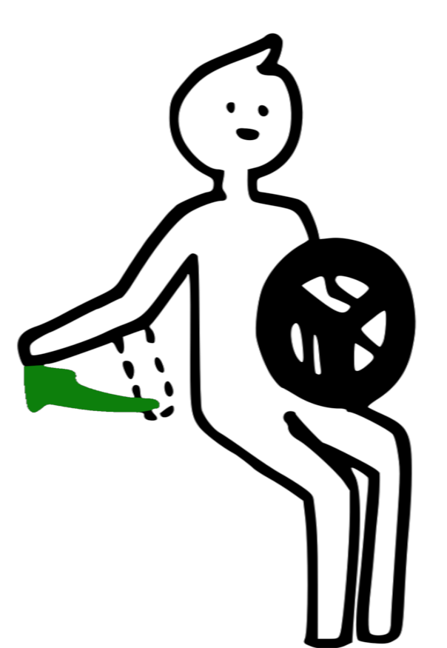
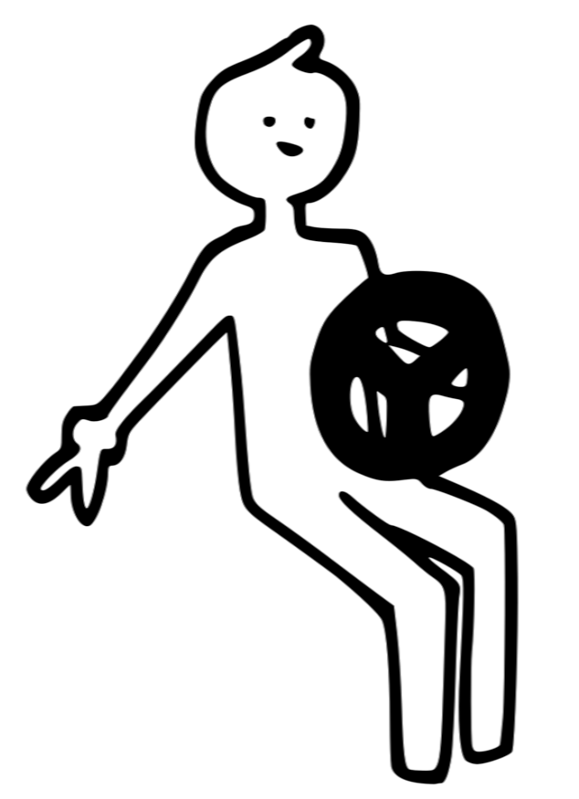
Research Studies
Notes:
The three novel feedback techniques presented so far were developed, tested and analysed in 7 studies with over 120 participants.

Slide 9
Main Results
Cutaneous Push can be an effective way of message presentation
Cutaneous Push has very high user acceptance,
The feedback techniques support gesture interaction without
RQ3 & RQ4: even during more challenging driving non-visual feedback combinations caused significantly lower Eyes-Off-the-Road Time, and least impact on driving behaviour, without any negative impact on cognitive loads.
Notes:
Cutaneous Push can be an effective way of message presentation
Cutaneous Push has very high user acceptance,
The feedback techniques - despite being low in resolution - support gesture interaction without impacting driving negatively,
even during more challenging driving non-visual feedback combinations caused significantly lower Eyes-Off-the-Road Time, and least impact on driving behaviour, without any negative impact on cognitive loads.

Slide 10
Research Impact
Real world impact
7 publications with almost 80 citations
Cutaneous Push is gaining traction
Notes:
This research has been published in 7 papers with almost 80 citations by now.
This work, and the novel feedback techniques presented here have had real world impact as they have reached researchers at BMW and Jaguar Landrover, helping them improve their gesture interfaces and the way the present feedback to gestures. This research makes driving safer.
Further, other research labs have picked up on Cutaneous Push and are embedding the feedback in the arm rests of a car, etc
It is exciting for me personally to see the impact.

Slide 11




Many Thanks
Stephen Brewster John Williamson
This project has received funding from the Europeans Union's Horizon 2020 research and innovation programme under grant agreement N° 645145.
Notes:
Finally, many, many thanks to my amazing supervisors, who have given me unfailing support.

Slide 12
Thank You & Questions
Gözel Shakeri
Email: Gozel.Shakeri@Glasgow.ac.uk
Web: https://gozel.github.io/gozel

